Slide 1





OPERATING SYSTEM MINI PROJECT
CSC 403
EXAM SYSTEM
GROUP - 7
FOURTH SEMESTER SESSION: 2025

Slide 2
OUR TEAM
SOUNAK BHATTACHARYA 23CS8161
RAGE SAI SANTOSH 23CS8162
AAYUSH
23CS8163
AHMED KHALID HAFIZ
23CS8164
RAJ PATEL
23CS8165
AMAN KACHHAP
23CS8166
ABIR SOREN
23CS8167
SNEHA SAHA
23CS8168
MAMPI MAHATO
23CS8169
AMAN BRIJBHUSHAN CHAUHAN
23CS8170

Slide 3

PROBLEM DESCRIPTION
In the digital age, online assessments have become an essential part of education, requiring platforms that are secure, scalable, and efficient. This project aims to develop an MCQ-Based Online Exam Platform that enables course instructors to create and manage exams while allowing students to take tests with real-time evaluation and performance analysis.

Slide 4
PRIMARY OBJECTIVE
Terminal-Based MCQ System: Conduct efficient online assessments seamlessly.
Question Bank Upload: Instructors can add .txt-based questions with answer keys & grading policies.
Secure authentication using hashed passwords for registration & login.
Dynamic shuffling to prevent identical question/order for adjacent students.
Real-time grading with instant performance feedback.
Robust system with error handling & redundancy.
Offline Readiness: Preload questions to ensure continuity even during network failures. Dual Mode: Functions as both an exam platform and a practice app for students.
Time-Based Cheating Detection: Track average solve time for each difficulty.

Slide 5
SECONDARY OBJECTIVE
Practice Mode: Allows students to attempt random questions from a selected topic from a question bank.
Browser Restriction: Ensure all other browsers are closed during the test.
Flexible Question Import: Add questions from multiple raw files, pdfs or extract from a source webpage.
Instructor Alerts: Notify instructors of potential cheating based on abnormal response patterns.

Slide 6













SYSTEM WORKFLOW
CLIENT CODE
VERIFICATION
1
Decode Hashed Password
Login
Authentification
Registration
3
Registration
4
2
USER
START EXAM
RESPONSE
FETCH LOGIN INFO
1
FILES
STUDENT
THREAD
STUDENT
UPLOAD SEAT MATRIX
GET PAPER
7
INSTRUCTOR
1
STORE FILES
EXAM STARTED
UPLOAD EXAM
2
ENCRYPTED PAPER
5
6
Request
REQUEST
2
SUBMIT
ANSWER
RESPONSE
8
DECRYPT PAPER
3
FETCH QUESTION ANSWER
1.View
uploaded Exam
2.Show
student
performance
Request
STORE PARSED EXAM
9
1.VIEW DASHBOARD
2.VIEW
AVAILABLE EXMAS
3
EXAM FILES
EVALUATE
SERVER
4
10
SAVE
RESULTS
Request
RESPONSE
Request
SERVER
RESPONSE
FETCH
send
FETCH
Server
send
Server

Slide 7
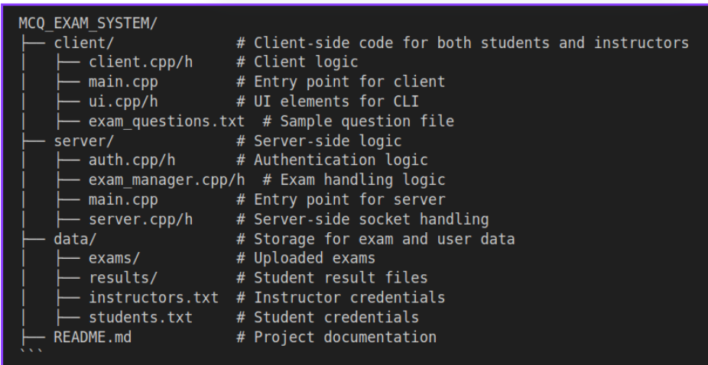
MODULAR DESIGN
FILES STRUCTURE

Slide 8
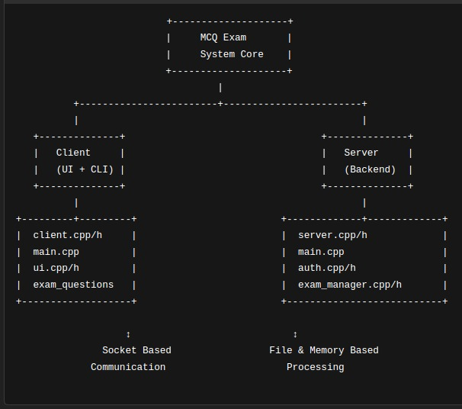
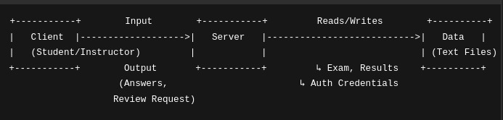
BASIC STRUCTURE
MODULAR DESIGN
BASIC STRUCTURE

Slide 9
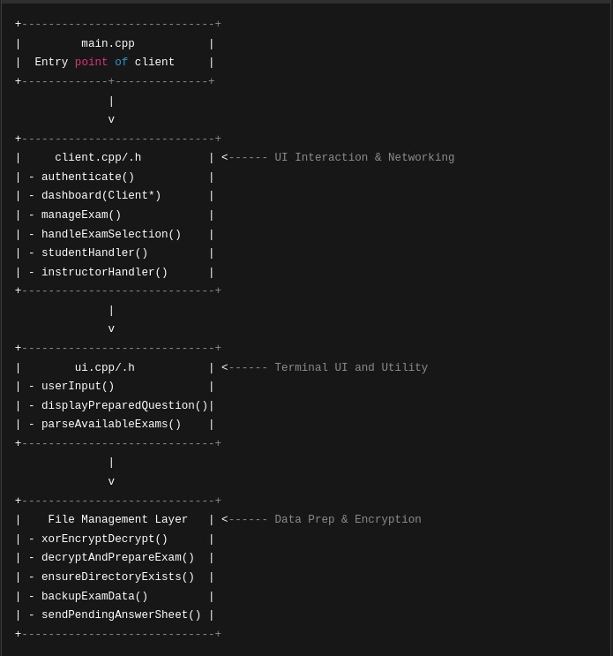
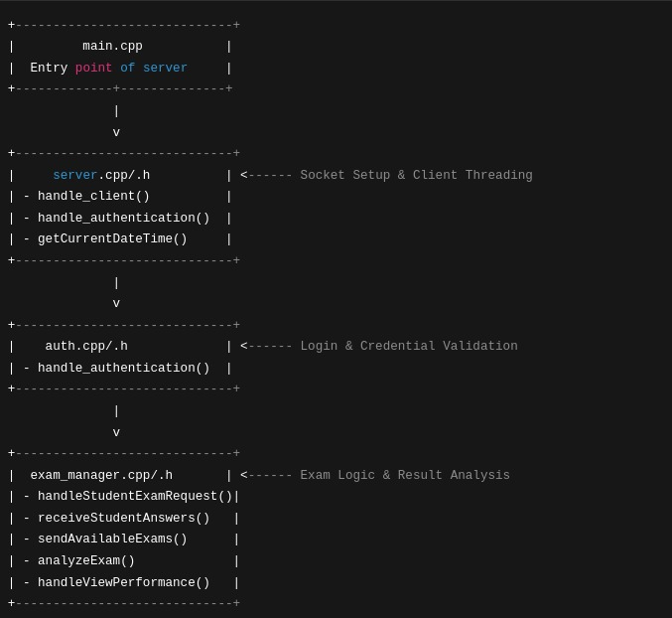
MODULAR DESIGN
CLIENT
SERVER

Slide 10
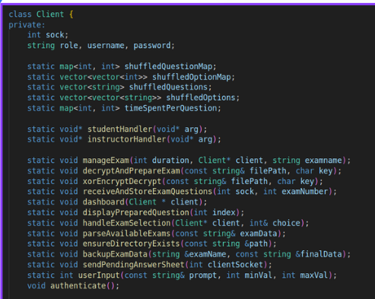
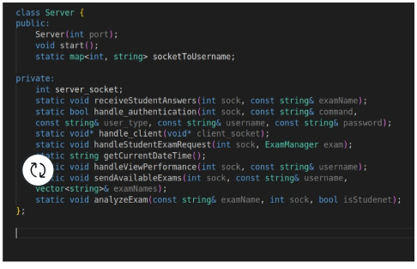
SERVER:
MODULAR DESIGN
CLIENT
SERVER

Slide 11
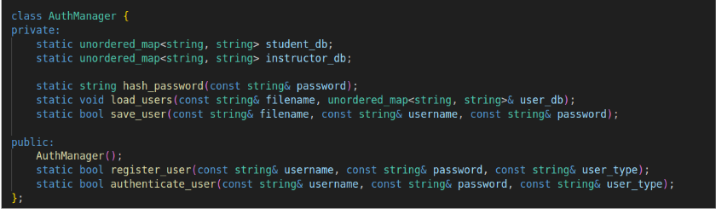
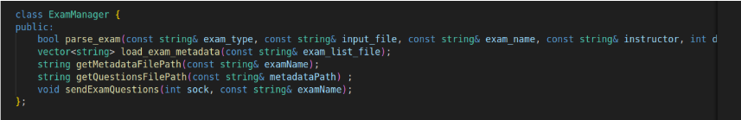
SERVER:
MODULAR DESIGN
AUTHENTICATION MANAGER :
EXAM MANAGER:

Slide 12
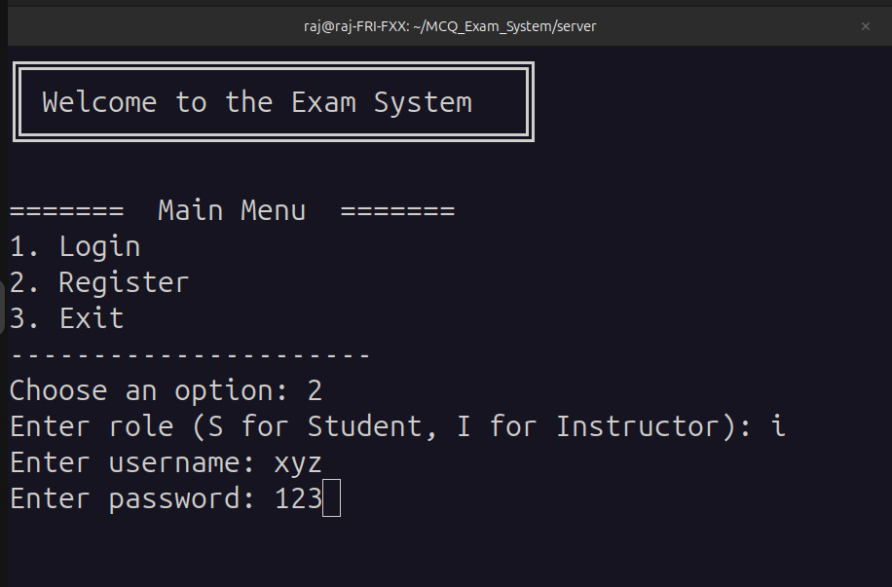
USER FRIENDLY TEXT INTERFACE
WELCOME PAGE

Slide 13
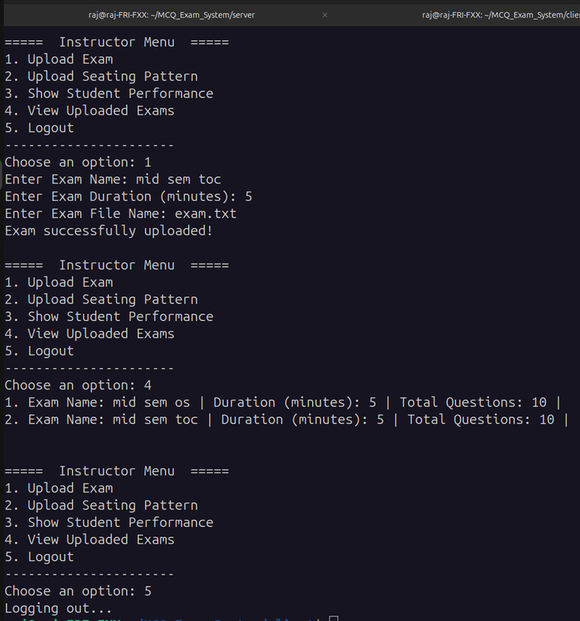
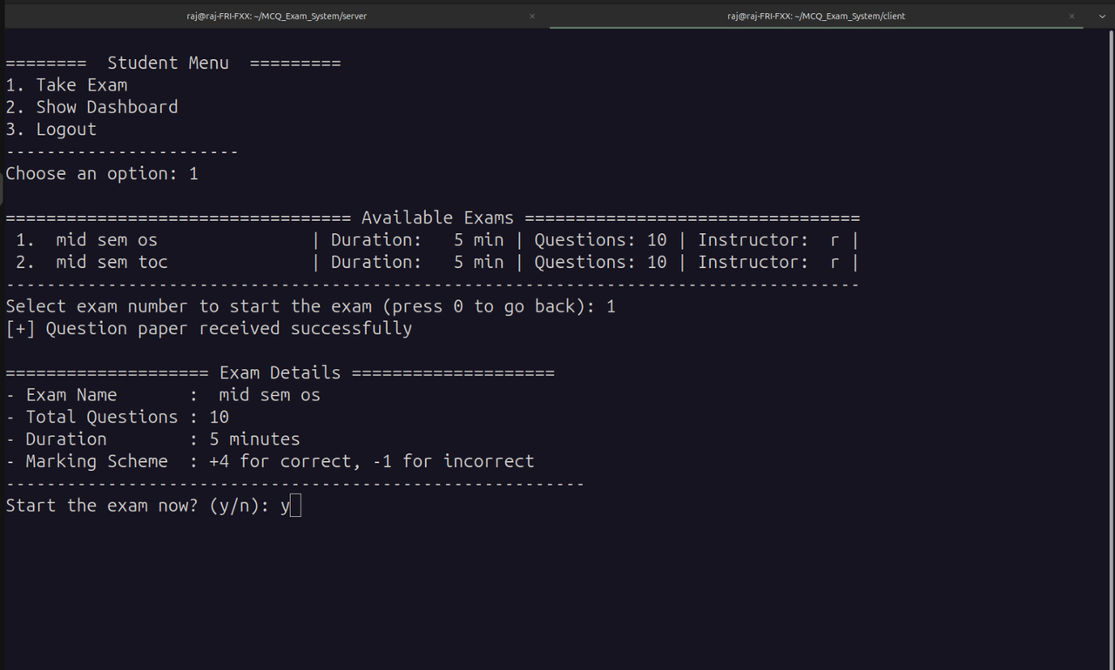
USER FRIENDLY TEXT INTERFACE
Teacher Interface
Student Interface

Slide 14
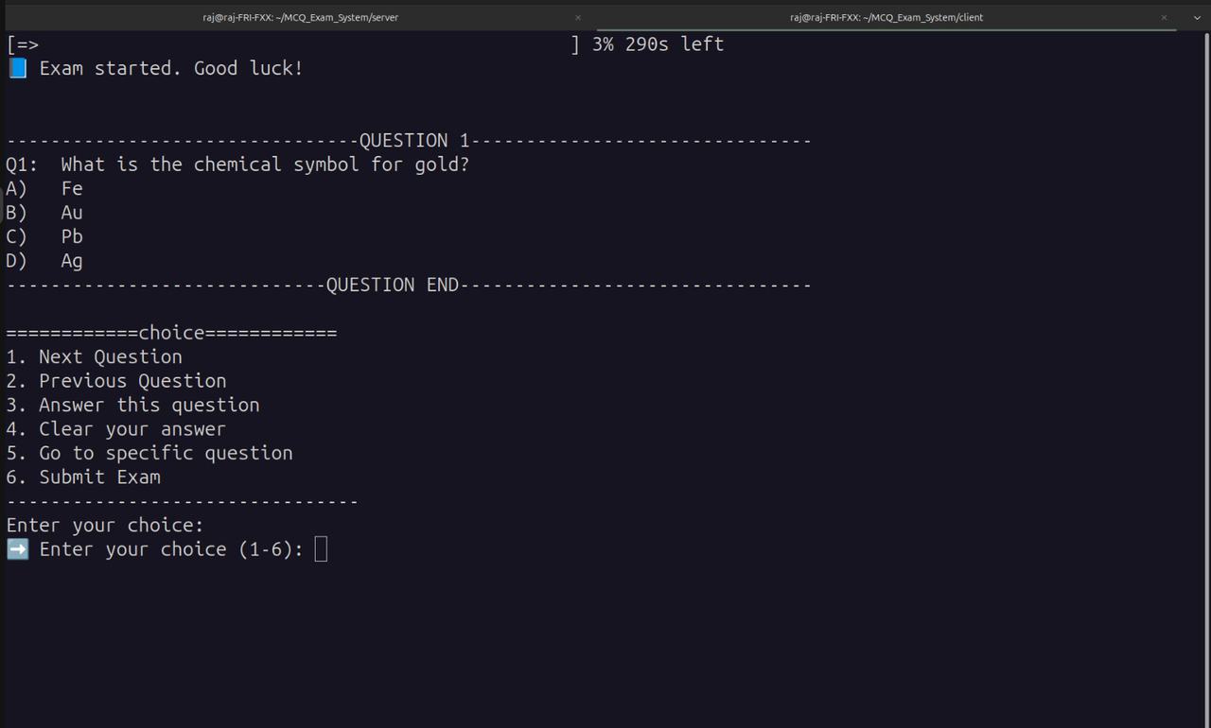
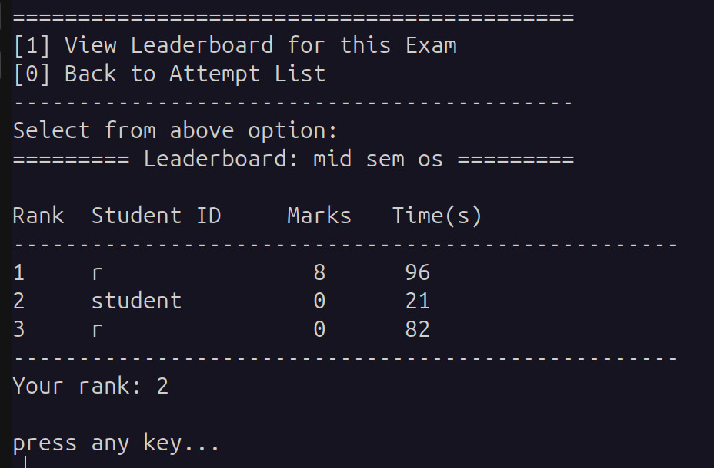
USER FRIENDLY TEXT INTERFACE
EXAM INTERFACE
LEADERBOARD INTERFACE

Slide 15
SYSTEM ARCHIETECTURE
SERVER INTERFACE
CLIENT INTERFACE
clientList
examDataList
LoginInfo
(Student/Instructor)
Role
Username
Password
TCP Connection
startServer
handleClient
loadUsers
loadExamData
VerifyOrAddUser
parseExamFile
RemoveClient
connect
selectAction
sendRequest
recvResponse
ExamData
ExamManager
examName
duration
questionsFile
answersFile
metadataFile
(Exam-taking, Results, etc.)
parseExamFile
storeExamMetadata
updateExamlist

Slide 16
FEATURES USED
MULTITHREADING
THREAD LOCKING
FILE HANDLING
FEATURES
OF
OPERATING SYSTEM
USED
SOCKETS
BUFFER MANAGEMENT

Slide 17




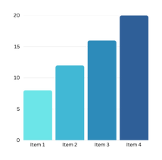
APPLICATION LEVEL FEATURES
Students can take exams from anywhere, reducing the need for physical presence.
Instructors can create, schedule, and manage exams remotely.
Eliminates printing costs and manual grading efforts.
Saves time with automated grading and instant results.
Instructors can define grading policies, question banks, and time limits.
Adaptive question selection improves exam fairness.
User authentication with hashing the password.
Prevents unauthorized access through different files based on client roles.
Question & options shuffling ensures fairness by preventing cheating.
Students receive immediate results and performance statistics.
Instructors can track student progress and analyze trends over time.

Slide 18


TIMELINE GOALS
15/5/2025
Finalize a stand alone version of project
24/03/2025
17/4/2025
Code review with
user feedback
First round of code completion and review
22/03/2025
PPT completion and initial class designs
21/03/2025
Final draft of ppt and UI planning

Slide 19





FUTURE ENVISIONS
Graphical User Interface (GUI): Upgrade from a text-based
system to a web or desktop application for better usability
2. Cloud Deployment: Host the exam system on cloud platforms (AWS/GCP) for global accessibility.
3. AI-Based Proctoring: Implement AI-driven monitoring to
prevent cheating via webcam & screen tracking.
4.Enhancing accessibility with screen readers, voice commands, adaptive timing, and multi-sensory support for specially-abled users.
5. Multi-Language Support: Enable exams in multiple
languages.

Slide 20
PROJECT RESPONSIBILITY
1
Aman Chauhan, Ahmed Khalid Hafiz
System Design
2
All the Team Members
Project Planning
3
Raj Patel, Sounak Bhattacharya
CODING
4
Sneha Saha, Mampi Mahato
PPT DESIGN
5
Aman Kachhap, Rage Sai Santosh
UI INTERFACING
6
Abir Soren, Aayush
RESOURCE MANAGEMENT

Slide 21
THANK
you
-BY GROUP 7

